Slide 1
Generalizing of Pollock’s particle-tracking method to unstructured MODFLOW 6 grids
Introduction to Groundwater Modeling with MODFLOW 6
MODFLOW & More, June 6, 2019

Slide 2
Goal
Pollock’s method tracks particles on rectangular (and quad-refined) meshes
Want to generalize it to work on arbitrary, unstructured MODFLOW 6 grids
How to do it as straightforwardly as possible?

Slide 3
Pollock’s method
Independent, 1D, linear interpolations of v_{x} and v_{y} on a rectangle
Solves analytically for exit time & location
Simple and elegant!
v_{y}
v_{x}
v_{x}
v_{y}

Slide 4
Pollock’s method from another angle

Slide 5
Pollock’s method from another angle
Define vertex velocities

Slide 6
Pollock’s method from another angle
Define vertex velocities
Interpolate linearly between them (“barycentric” interpolation)
Same idea in the upper triangle
50%
10%
40%

Slide 7
Pollock’s method from another angle
On a rectangle, equivalent to Pollock’s interpolation
50%
10%
40%

Slide 8
Generalizing Pollock’s method
Convex polygon
Given edge normal velocities
v_{n}
v_{n}
v_{n}
v_{n}
v_{n}

Slide 9
Generalizing Pollock’s method
Convex polygon
Given edge normal velocities
Define vertex velocities
v_{n}
v_{n}
v_{n}
v_{n}
v_{n}

Slide 10
Generalizing Pollock’s method
Convex polygon
Given edge normal velocities
Define vertex velocities
Triangulate
Barycentric interpolation

Slide 11
Barycentric coordinates
β=1
y
x
transform
β=0
α=0
α=1
model coordinates (x,y)
barycentric coordinates (α,β)

Slide 12
Tracking across triangular subcell
Formulate equations for trajectory
Solve for trajectory analytically
Solve for exit location & time numerically
(γ =1- α- β)
γ =0 edge
α=0 edge
β =0 edge

Slide 13
Trajectory equations
(2)
triangle vertex velocities
(0)
(1)
${\frac{dα}{dt}=v}_{α}=v_{α}^{(0)}+\left(v_{α}^{(1)}−v_{α}^{(0)}\right)α+$ $\left(v_{α}^{(2)}−v_{α}^{(0)}\right)β$
${\frac{dβ}{dt}=v}_{β}=v_{β}^{(0)}+\left(v_{β}^{(1)}−v_{β}^{(0)}\right)α+$ $\left(v_{β}^{(2)}−v_{β}^{(0)}\right)β$
linear change in velocity as you move away from vertex 0

Slide 14
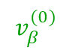
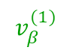
Trajectory equations
${\frac{dα}{dt}=v}_{α}=v_{α}^{(0)}+\left(v_{α}^{(1)}−v_{α}^{(0)}\right)α+$ $\left(v_{α}^{(2)}−v_{α}^{(0)}\right)β$
${\frac{dβ}{dt}=v}_{β}=v_{β}^{(0)}+\left(v_{β}^{(1)}−v_{β}^{(0)}\right)α+$ $\left(v_{β}^{(2)}−v_{β}^{(0)}\right)β$
=0
$$v_{β}^{(0)}$$
$$v_{β}^{(1)}$$
(0)
(1)

Slide 15
Trajectory equations
${\frac{dα}{dt}=v}_{α}=v_{α}^{(0)}+\left(v_{α}^{(1)}−v_{α}^{(0)}\right)α+$ $\left(v_{α}^{(2)}−v_{α}^{(0)}\right)β$
${\frac{dβ}{dt}=v}_{β}=v_{β}^{(0)}+\left(v_{β}^{(1)}−v_{β}^{(0)}\right)α+$ $\left(v_{β}^{(2)}−v_{β}^{(0)}\right)β$
decoupled (β only)
solve for β{t} analytically

Slide 16
Trajectory equations
plug β{t} into top equation
solve for α{t} analytically
${\frac{dα}{dt}=v}_{α}=v_{α}^{(0)}+\left(v_{α}^{(1)}−v_{α}^{(0)}\right)α+$ $\left(v_{α}^{(2)}−v_{α}^{(0)}\right)β$
${\frac{dβ}{dt}=v}_{β}=v_{β}^{(0)}+\left(v_{β}^{(1)}−v_{β}^{(0)}\right)α+$ $\left(v_{β}^{(2)}−v_{β}^{(0)}\right)β$

Slide 17


Trajectory solution
5 cases (functional forms)
Nicest case:
Ugliest case:
$$α=α_{0}+A_{4}t+B_{4}t^{2}$$
Typically can’t “invert” to get t as a function of $α$
$$β=β_{0}+C_{4}t$$
$$α=−A_{1}+B_{1}exp\left\{δ_{2}t\right\}+\left(α_{0}+A_{1}−B_{1}\right)exp\left\{δ_{1}t\right\}$$
$$β=−C_{1}+\left(β_{0}+C_{1}\right)exp\left\{δ_{2}t\right\}$$
Can always “invert” to get t as a function of$β$

Slide 18
Solving for the exit point
Identify outflow interval for edge (e.g., α=0 edge)
Further constrain using properties of β{t}
Find intersection of trajectory with outflow interval
α{t}<0
α{t}=0
“bracket” the root
α{t}>0
looking for root α{t}=0

Slide 19
Solving for the exit point
Brent’s method
Combination of secant method and bisection
Keeps root bracketed

Slide 20
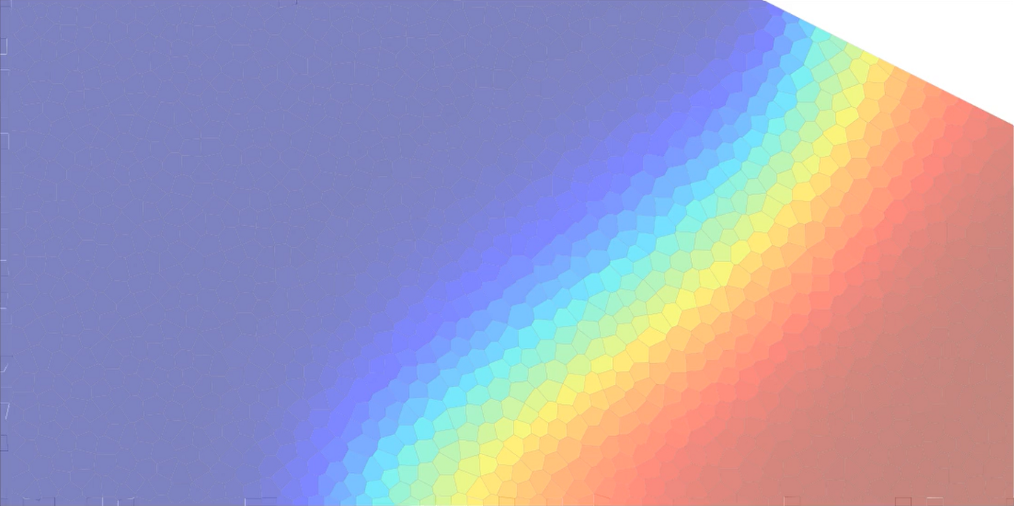
2D example
“Henry-like” problem
Unstructured grid of Voronoi polygons

Slide 21
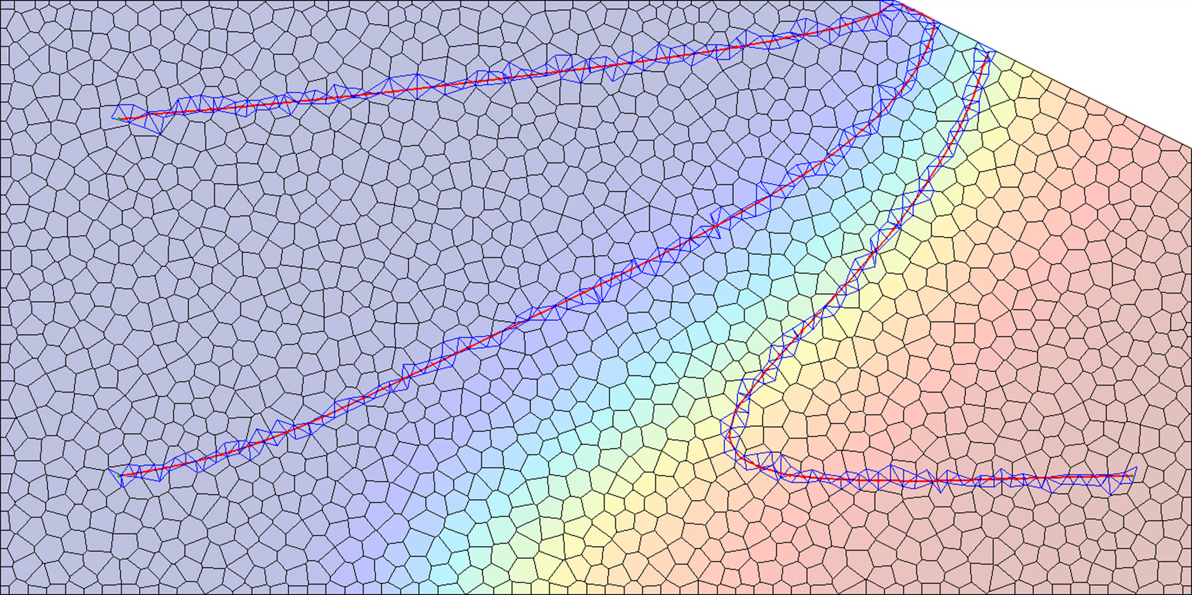
2D example
“Henry-like” problem
Unstructured grid of Voronoi polygons

Slide 22
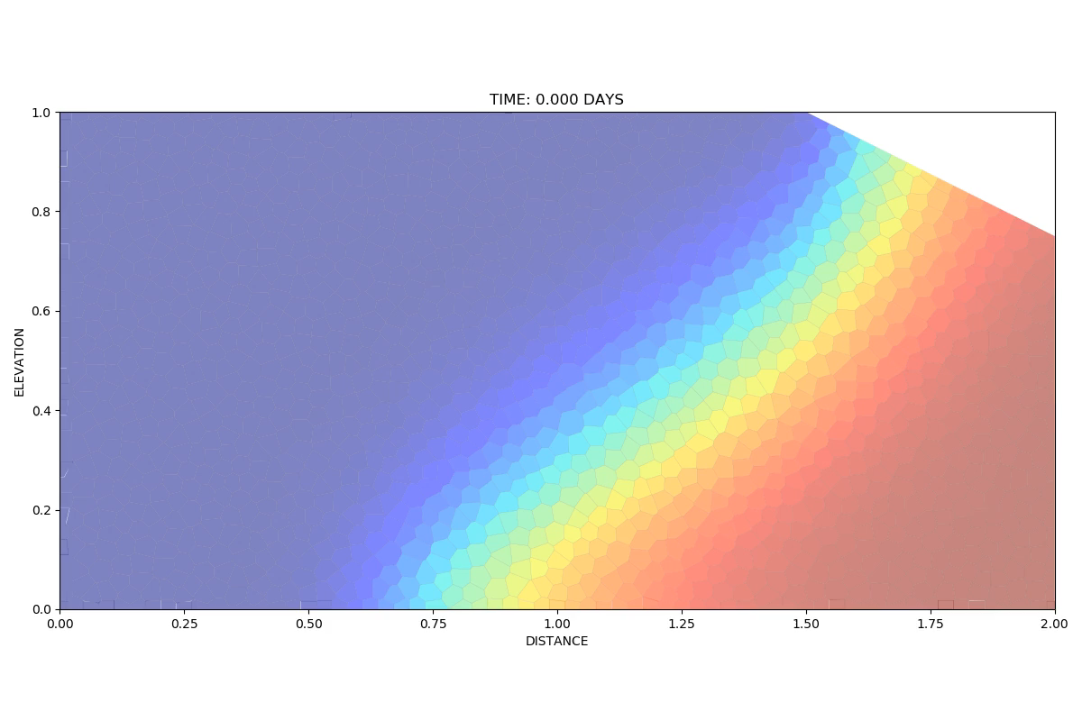

Slide 23
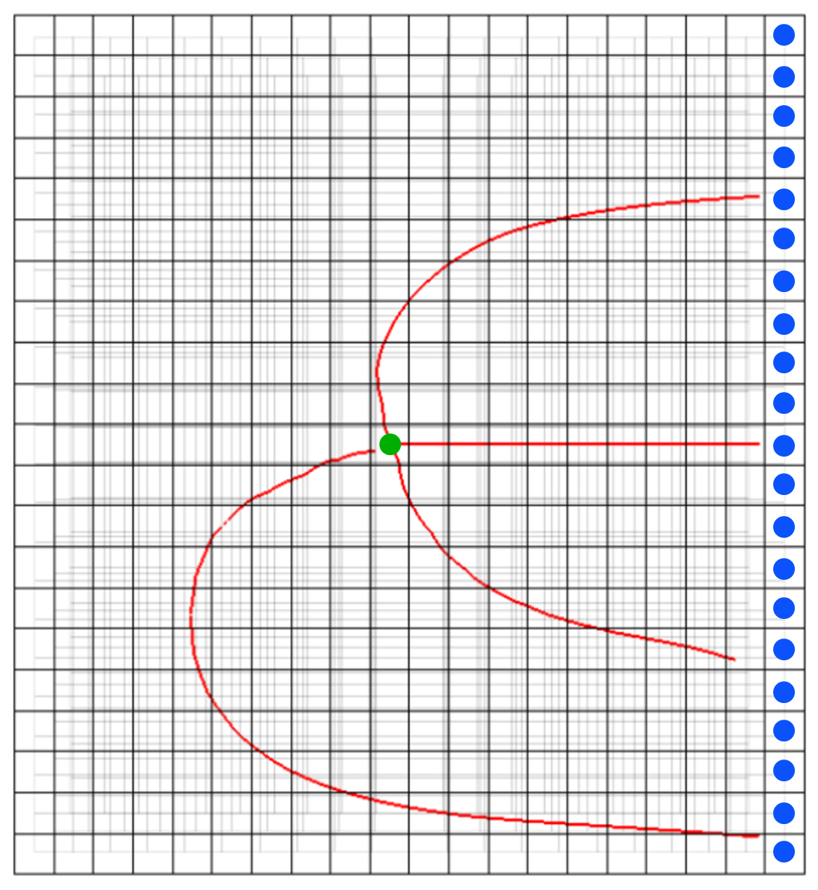
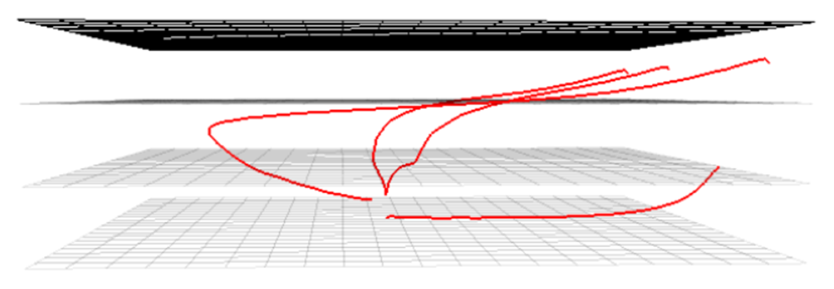
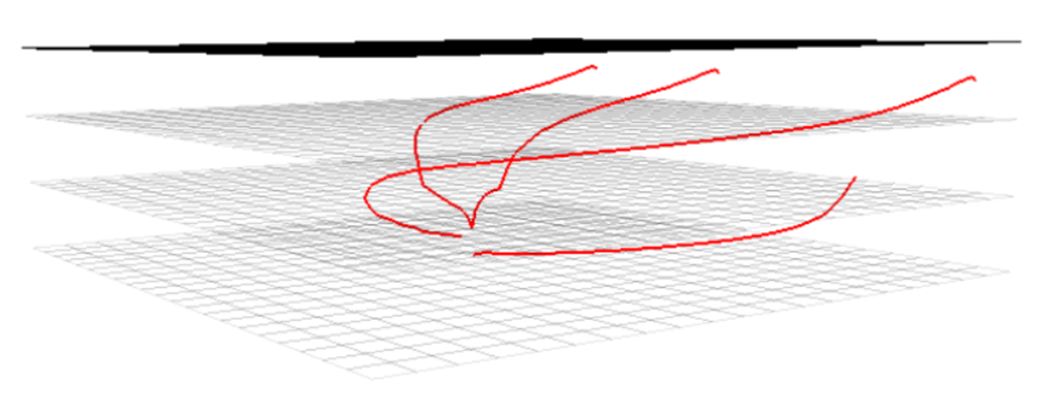
3D example
Regular grid, 3 layers
Well in bottom layer
well (layer 3)
constant-head cells (layer 1)

Slide 24
Conclusions
Generalization of Pollock’s method to unstructured MF6 grids (cells are convex polygonal prisms)
Results from a prototype code look promising
Plan to incorporate and test within MODPATH

